Slide 1
NLP STUDY ASSIGNMENT

Slide 2
Word Embeddings:
Word Embedding or Word Vector is a numeric vector input that represents a word in a lower-dimensional space. It allows words with similar meanings to have a similar representation. They can also approximate meaning.
A word vector with N values can represent N unique features (Relates words to one another). Their goal is to reduce the dimensionality, predict the words around a word, and capture inter-word semantics.
They are used as input to ML Models, representing/visualizing patterns of usage in the corpus.

Slide 3
Earlier Methods:
Methods such as Bag of Words, CountVectorizer, and TFIDF rely on the word count but do not save any syntactical or semantic information.
The size of the vector is the number of elements in the vocabulary. We can get a sparse matrix if most of the elements are zero.
Large input vectors will mean a huge number of weights, resulting in high computation required for training. Word Embeddings give a solution to these problems.

Slide 4
Word2Vec:
Each word is assigned a random or one-hot vector (A representation where only one bit in a vector is 1). In an N-word corpus, the vector length is N.
After assigning vectors, we take a window size and iterate through the corpus.
Two neural embedding methods are used:
Continuous Bowl of Words (Fit the neighboring words in the window to the central word)
Skip Gram (Make the central word closer to the neighboring words).
After applying the above neural embedding methods, we get trained vectors (preserve syntactical or semantic information and are converted to lower dimensions) of words after many iterations through the corpus. Vectors with similar meanings or semantic information are placed close to each other in space.

Slide 5
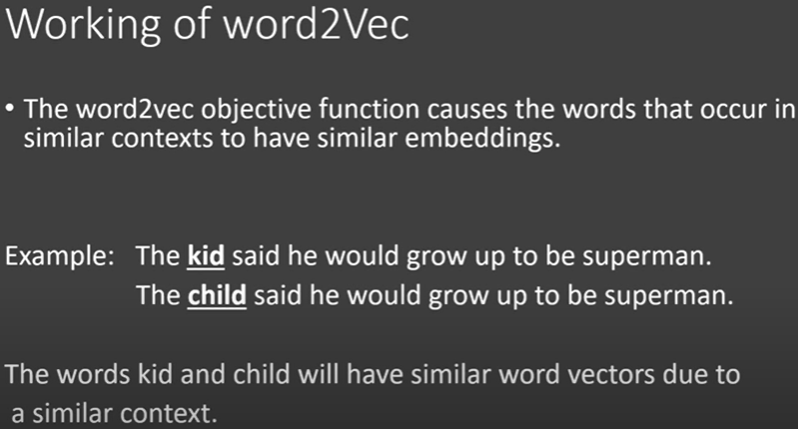

Slide 6
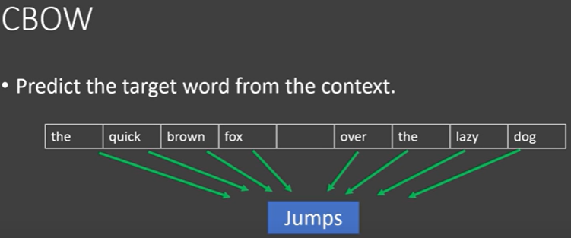
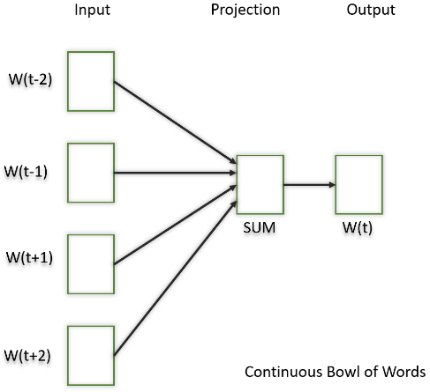
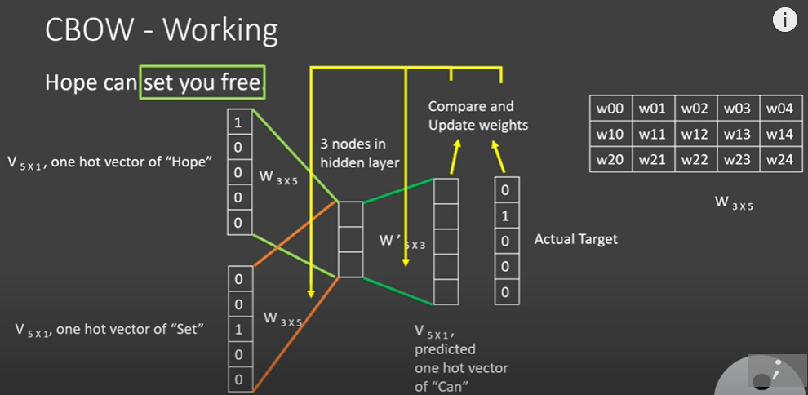
Continuous Bowl of Word

Slide 7
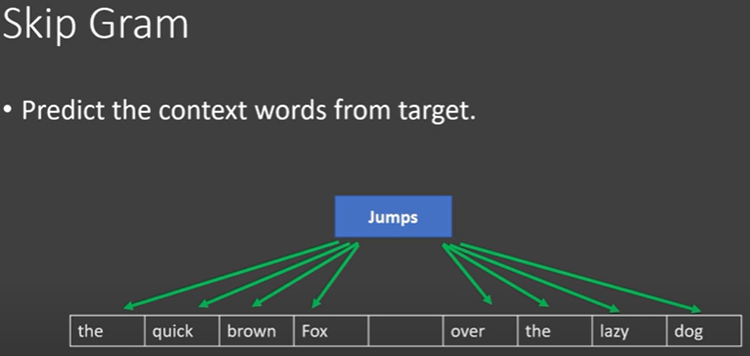
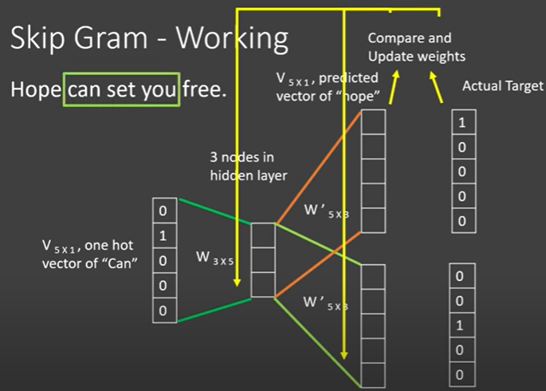
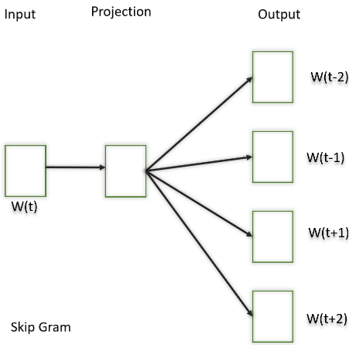
Skip Gram

Slide 8
GloVe:
Iterate through the corpus and get the co-occurrence matrix containing the co-occurrence of each word with other words.
Words that occur next to each other get value 1, one word apart 1/2, two words apart 1/3, and so on.
The upper half of the matrix will be a reflection of the lower half.
Consider a window frame to calculate the co-occurrences by shifting the frame till the end of the corpus. This helps gather information about the context in which the word is used.
Initially, the vectors for each word are assigned randomly. Then we take two pairs of vectors and see how close they are to each other in space.
If they occur together more often or have a higher value in the co-occurrence matrix and are far apart in space, they are brought closer to each other. If they are close to each other but are rarely or not frequently used together then they are moved further apart in space.
After many iterations of the above process, we’ll get a vector space representation that approximates the information from the co-occurrence matrix. The performance of GloVe is better than Word2Vec in terms of both semantic and syntactic capturing.

Slide 9
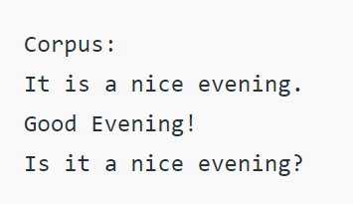
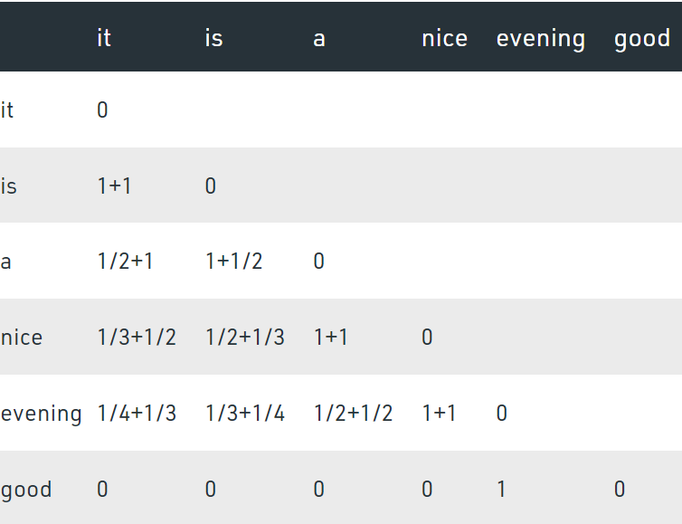
Co-occurrence Matrix
What might be an advantage of using character-level embedding over word-level embedding?
With character embedding, every word's vector can be formed even if it is out-of-vocabulary words (optional). On the other hand, word embedding can only handle those seen words.
Why is GloVe better than Word2Vec?
The additional benefit of GloVe over word2vec is that it is easier to parallelize the implementation which means it's easier to train over more data, which, with these models, is always A Good Thing.

Slide 10
Conclusion
Benefits of Word Embeddings:
Faster to train than hand-build models like WordNet (which uses graph embeddings), Almost all modern NLP applications start with an embedding layer, and it stores an approximation of meaning.
Drawbacks of Word Embeddings:
Memory intensive, Corpus dependent, cannot distinguish between homophones.
Collaborative filtering:
Similar products bought by multiple customers are embedded into a low-dimensional space. This low dimensional space will contain similar products close to each other, hence, it is also called as nearest neighborhood algorithm. This technique is used for placing semantically similar items close to each other.

Slide 11
Transformers

Slide 12

Why Transformers?
Transformer Architecture
Previously RNNs and LSTMs were used for NLP-related tasks.
Both took sequential input and were slow to train.
Transformer takes all tokens in a sentence at once.
It is an Encoder-Decoder Architecture

Slide 13
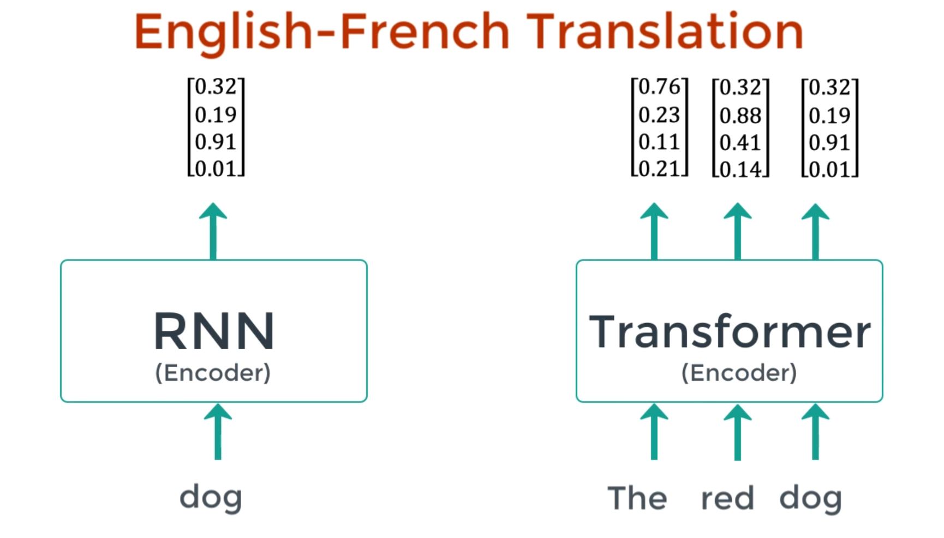

Slide 14
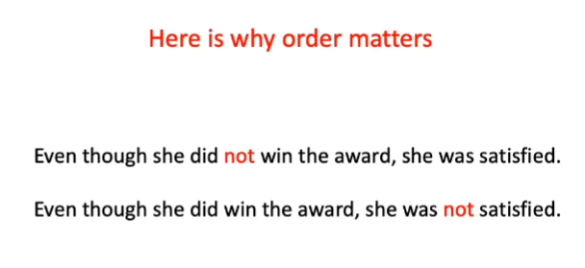
Text and Position Embedding
Since LSTM and RNN took sequential input, there was no need of positional information.
Transformer takes entire sentence as input at once

Slide 15
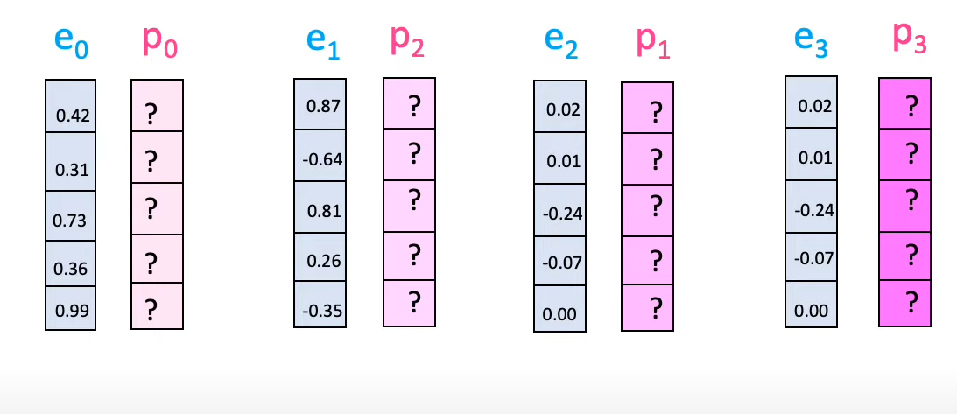
As explained in the Transformer
Word Embedding and Positional Embedding are simply added for each token.

Slide 16
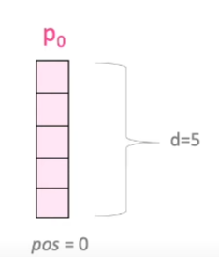
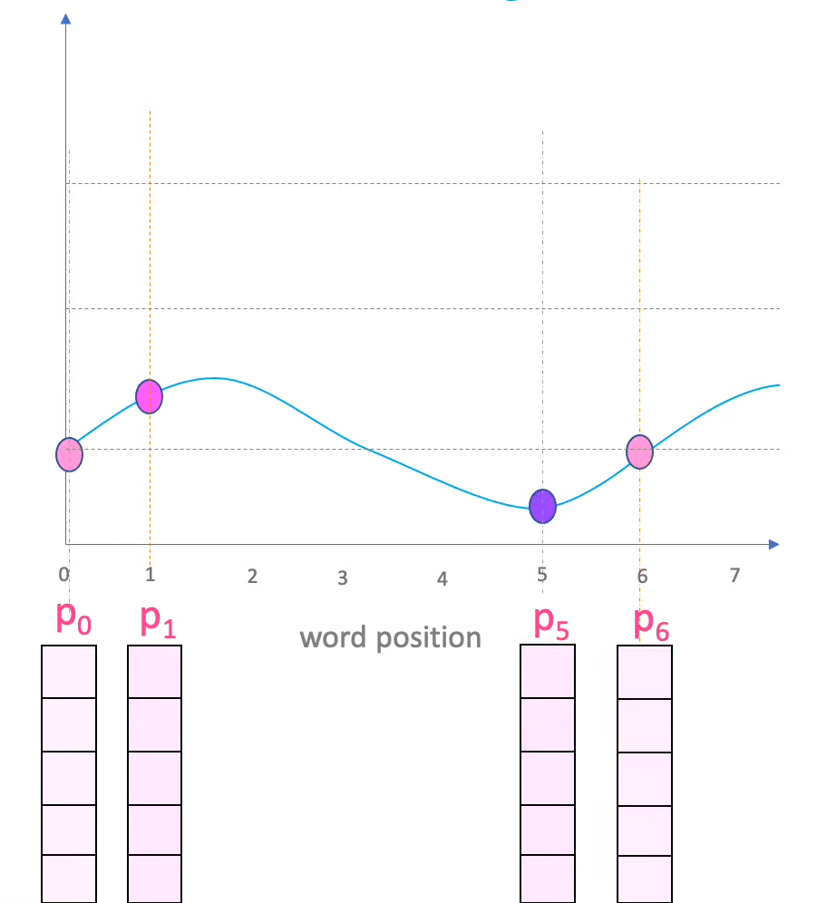
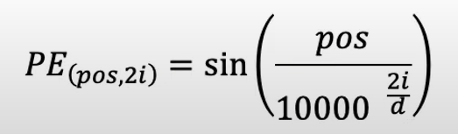
To calculate Positional Embedding..
Sin and cos functions are used to calculate position embedding for each token.
E.g. pos = 0, d = 5

Slide 17
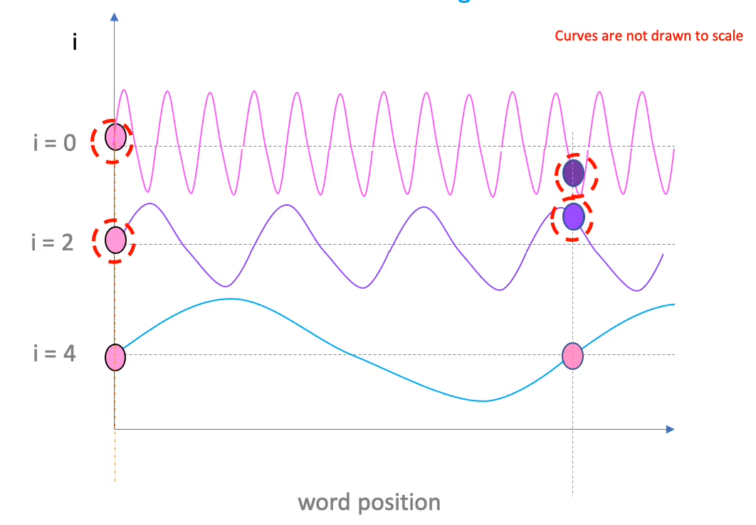

Slide 18
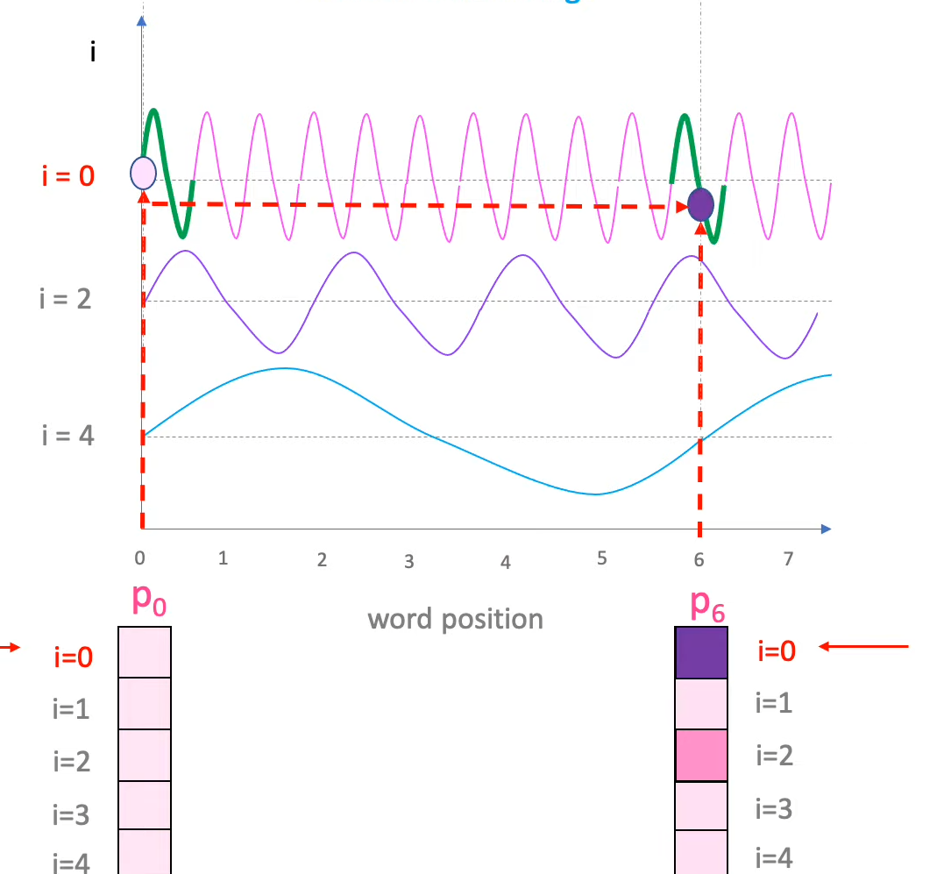

Slide 19
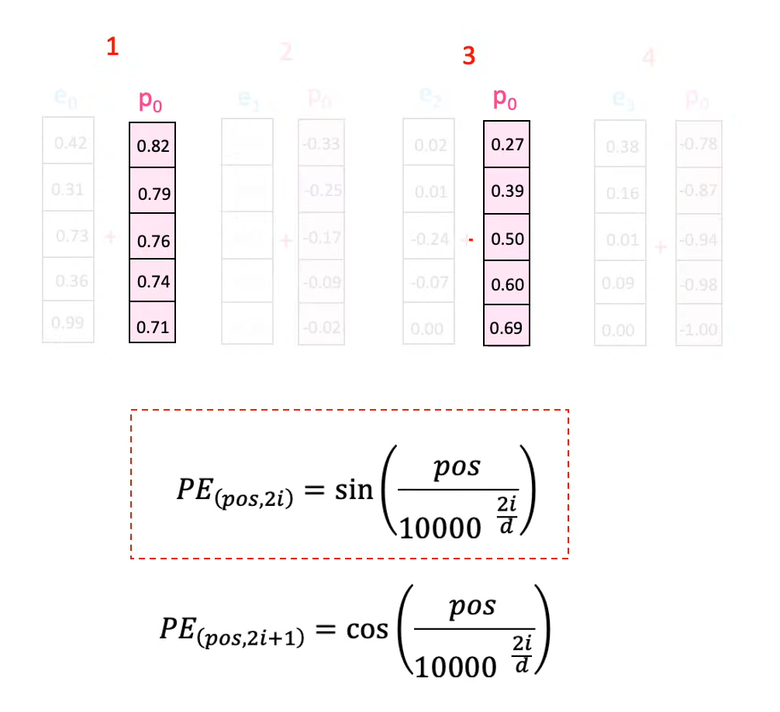
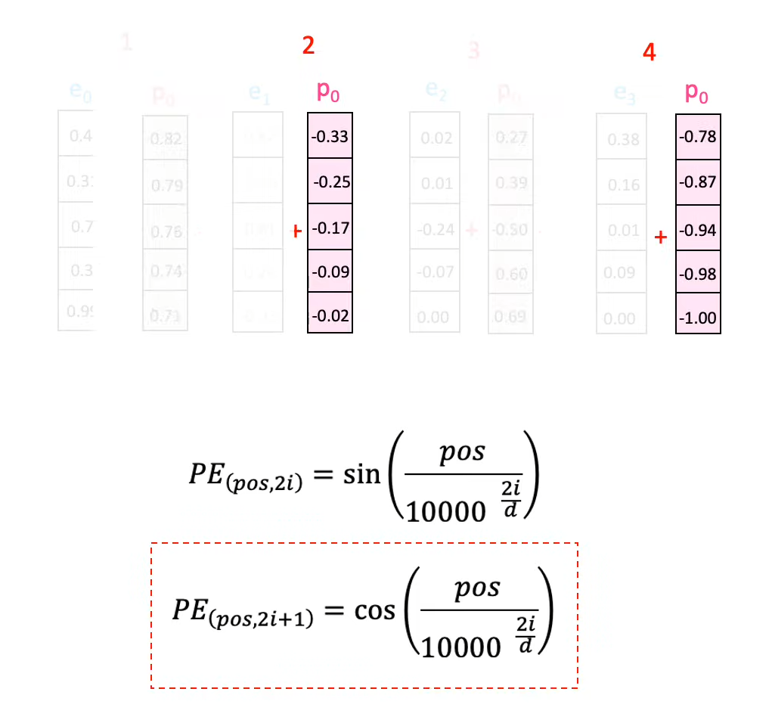
For ODD positions, sin was used
For EVEN positions, cos was used

Slide 20
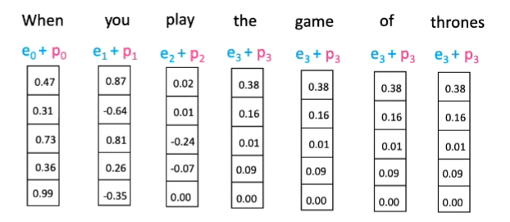

Slide 21
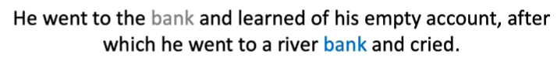
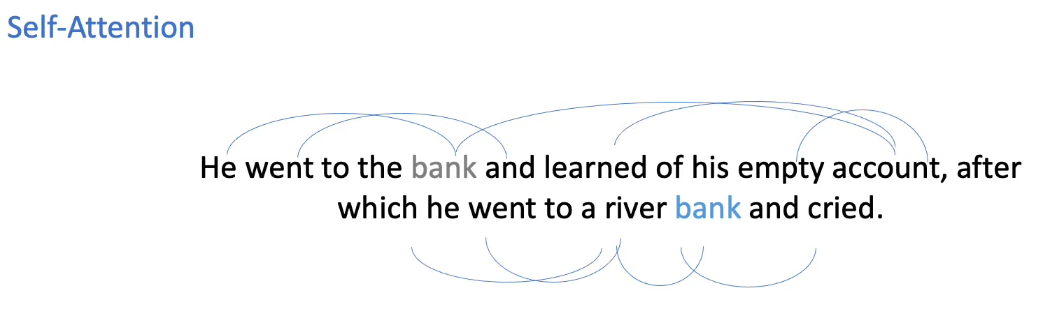
What is Attention?
It focuses on the important words in a given input sentence.

Slide 22
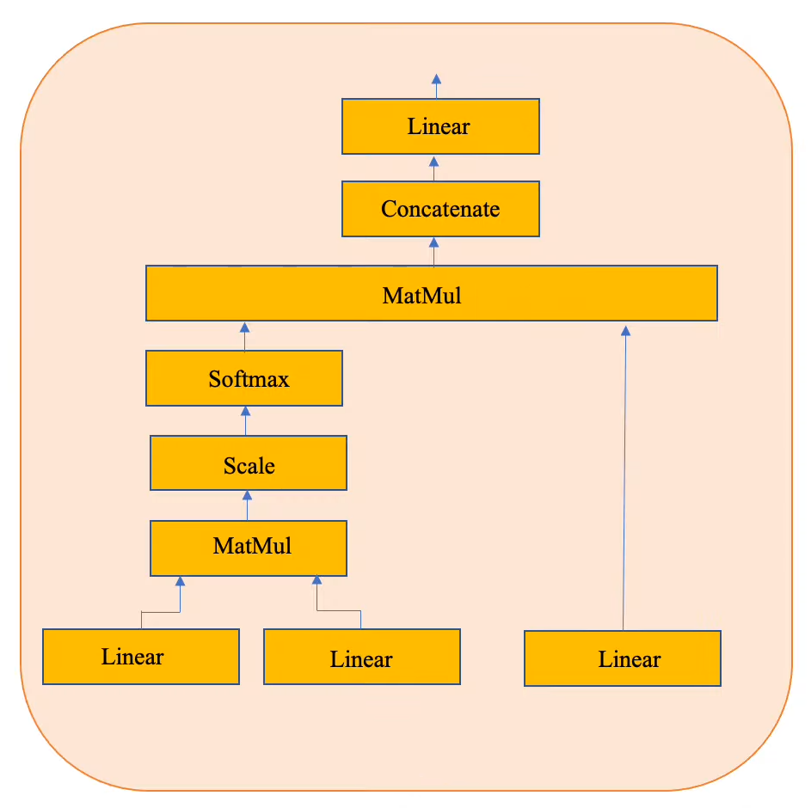
Multi Head Attention
Linear Layer :
Consists of 3 neurons
So if input is of the form 7 * 5 then output after linear layer will come 7 * 3 matrix

Slide 23
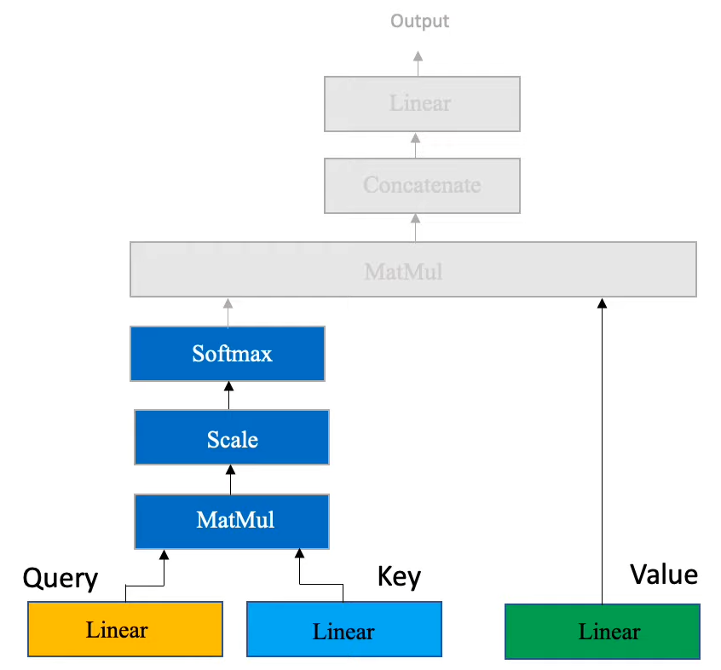
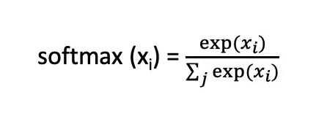
Multi-Head Attention
MatMul:
M= A * B(Transpose)
A : 7 * 3
B(Transpose) : 3 * 7
Scale : M = M / pow(d, 0.5), d: dimention of M
Softmax:

Slide 24
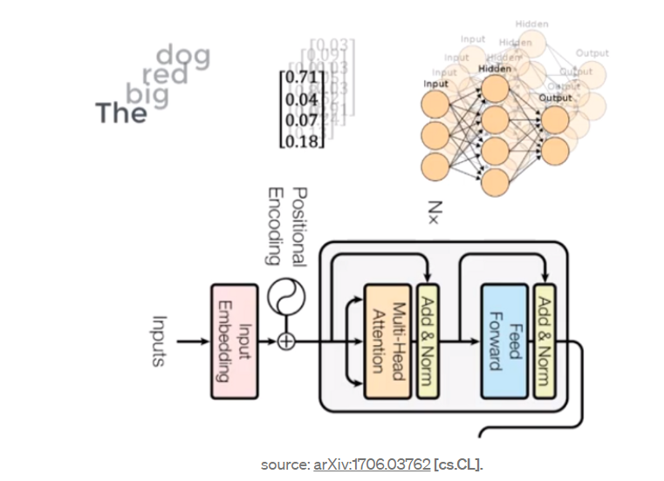
This is the simple feed-forward Neural Network that is applied to every attention vector, it’s the main purpose is to transform the attention vectors into a form that is acceptable by the next encoder or decoder layer.
Feed Forward Network accepts attention vectors “one at a time”. And the best thing here is unlike the case of RNN, here each of these attention vectors is independent of each other. So, parallelization can be applied here, and that makes all the difference.

Slide 25
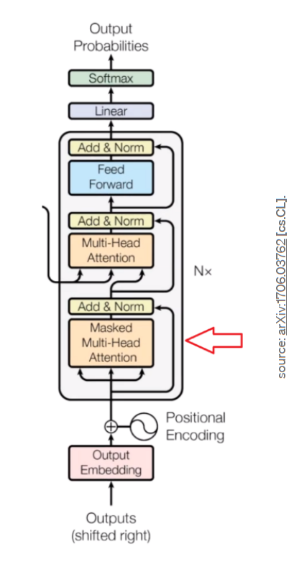
In case of English to French transalation
English sentence will go through encoder block.
Corresponding French sentence will go through decoder block so that model can learn.

Slide 26
Masking
Masked Multi Self Attention
MatMul:
M= A * B(Transpose)
A : 7 * 3
B(Transpose) : 3 * 7
Scale : M = M / pow(d, 0.5), d: dimention of M

Slide 27
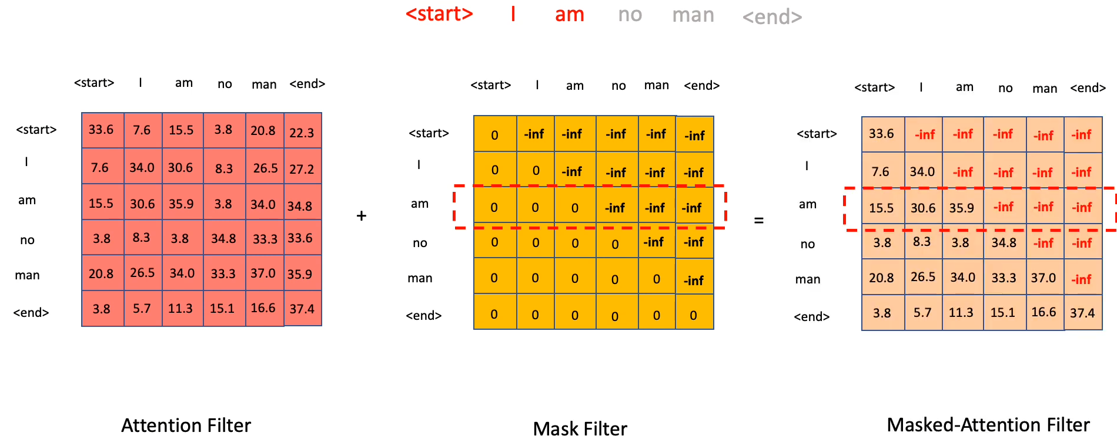
Masking

Slide 28
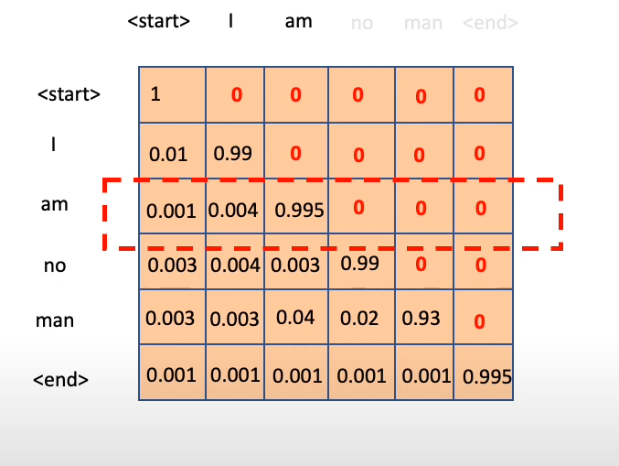
After Softmax..

Slide 29
So French words attention vectors are passed to Multi Head Attention
This Multi Head Attention has inputs from English words attention vectors as inputs
This is where the mapping happens between English and French sentences.

Slide 30
Now we pass each attention vector into a feed-forward unit, it will make the output vectors form into something which is easily acceptable by another decoder block or a linear layer.
A linear layer is another feed-forward layer. It is used to expand the dimensions into numbers of words in the French language after translation.
Now it is passed through a Softmax Layer, which transforms the input into a probability distribution, which is human interpretable.

Slide 31
GPT
Generative Pre Trained Transformer

Slide 32
Why GPT?
Various tasks such as semantic similarity assessment, textual entailment, document classification and question answering.
Special data set curated for such tasks were required.
Models failed miserably on other NLP tasks as they were especially trained on specific tasks.
It is mainly used for next token prediction and generating text from limited text.

Slide 33
GPT Training
Trained on booksCorpus data set which has 7000 un-published books.
GPT model was based on Transformer architecture.
12 decoders stacked on top of each other.
Model works on a principle called autoregressive the previous output becomes current input.

Slide 34
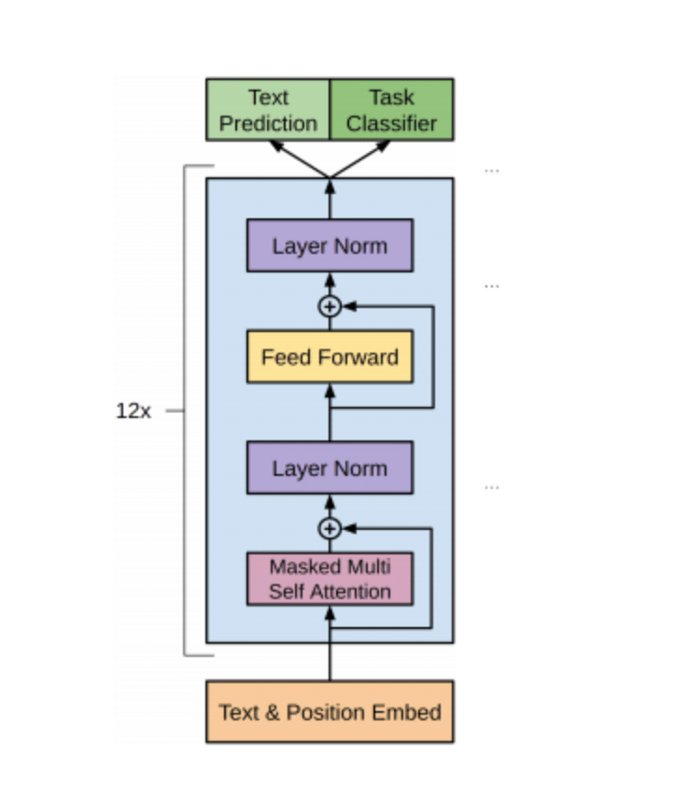
Architecture

Slide 35
Text and Position Embedding
Since LSTM and RNN took sequential input, there was no need of positional information.
Transformer takes entire sentence as input at once

Slide 36
As explained in the Transformer
Word Embedding and Positional Embedding are simply added for each token.

Slide 37
To calculate Positional Embedding..
Sin and cos functions are used to calculate position embedding for each token.
E.g. pos = 0, d = 5

Slide 40
For ODD positions, sin was used
For EVEN positions, cos was used

Slide 42
What is Attention?
It focuses on the important words in a given input sentence.

Slide 43
Self Attention
Linear Layer :
Consists of 3 neurons
So if input is of the form 7 * 5 then output after linear layer will come 7 * 3 matrix

Slide 44
Masking
Masked Multi Self Attention
MatMul:
M= A * B(Transpose)
A : 7 * 3
B(Transpose) : 3 * 7
Scale : M = M / pow(d, 0.5), d: dimention of M

Slide 45
Masking

Slide 46
After Softmax..

Slide 47
Feed Forward Network
The Multi-Heads Self-Attention mechanism is followed by two fully connected layers of the Feed Forward block.
The first (hidden) layer contains 4 times as many neurons as the input sequence with the ReLU activation function.
The dimension of the second layer is equal to the dimension of the input sequence, and neurons do not use the activation function.

Slide 48
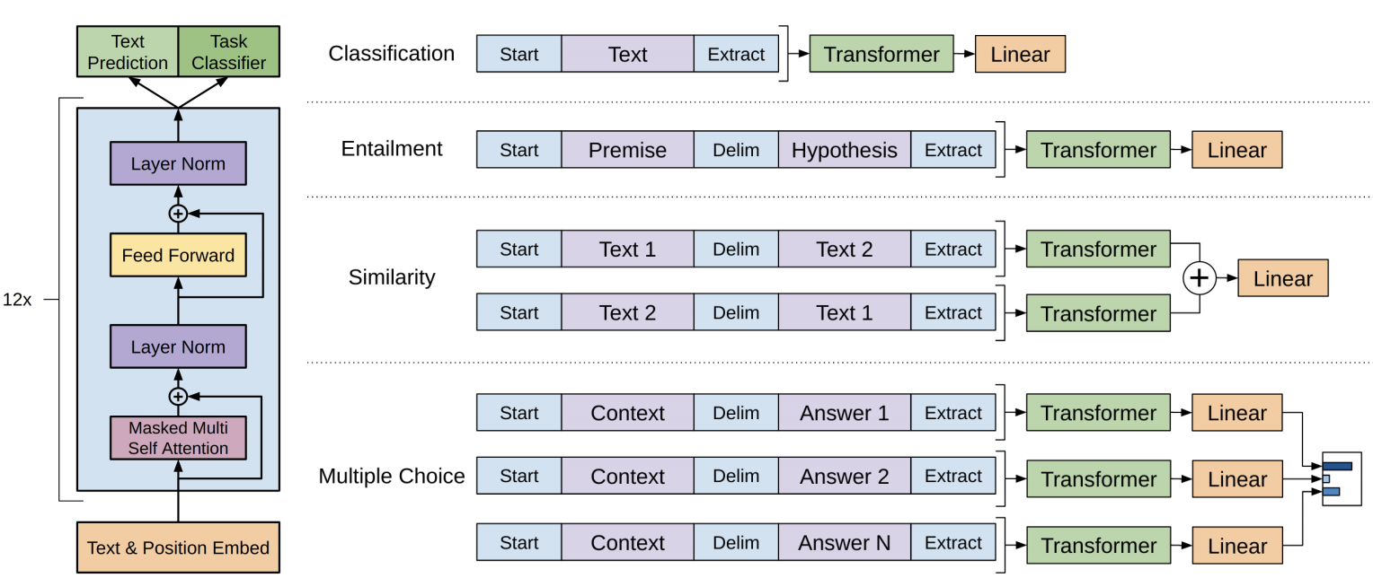

Slide 49
BERT
Bidirectional Encoder Representations from Transformers

Slide 50
Introduction
Recent paper published by researchers at Google AI Language.
Applying the bidirectional training of Transformer, a popular attention model, to language modeling.
Have a deeper sense of language context and flow than single-direction language models.
Learns the context of a word based on all of its surroundings (left and right of the word)

Slide 51
Architecture
BERT makes use of a Transformer, an attention mechanism.
Transformer includes two separate mechanisms — an encoder that reads the text input and a decoder that produces a prediction for the task.
Since BERT’s goal is to generate a language model, only the encoder mechanism is necessary.
The input is a sequence of tokens, which are first embedded into vectors and then processed in the neural network.
The output is a sequence of vectors of size H, in which each vector corresponds to an input token with the same index.
BERT uses 2 different strategies.

Slide 52
Architecture
Masked Language Model:
: Before feeding word sequences into BERT, 15% of the words in each sequence are replaced with a [MASK] token.
The model then attempts to predict the original value of the masked words, based on the context provided by the other, nonmasked, words in the sequence.
In technical terms, the prediction of the output words requires: Adding a classification layer on top of the encoder output, Multiplying the output vectors by the embedding matrix, transforming them into the vocabulary dimension, and Calculating the probability of each word in the vocabulary with softmax.

Slide 53
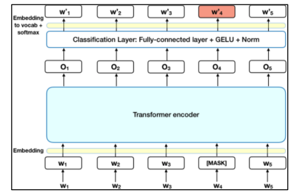
Architecture
Masked Language Model:

Slide 54
Architecture
Next Sentence Prediction:
Next Sentence Prediction: In the BERT training process, the model receives pairs of sentences as input and learns to predict if the second sentence in the pair is the subsequent sentence in the original document.
During training, 50% of the inputs are a pair in which the second sentence is the subsequent sentence in the original document, while in the other 50% a random sentence from the corpus is chosen as the second sentence.
A [CLS] token is inserted at the beginning of the first sentence and a [SEP] token is inserted at the end of each sentence
A positional embedding is added to each token to indicate its position in the sequence.

Slide 55
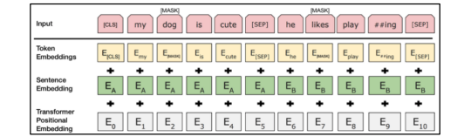
Architecture
Next Sentence Prediction:

Slide 56
Discussions
Training the language model in BERT is done by predicting 15% of the tokens in the input, that were randomly picked.
These tokens are pre-processed as follows — 80% are replaced with a “[MASK]” token, 10% with a random word, and 10% use the original word.
The intuition that led the authors to pick this approach is as follows.
If we used [MASK] 100% of the time the model wouldn’t necessarily produce good token representations for non-masked words.
The non-masked tokens were still used for context, but the model was optimized for predicting masked words.
If we used [MASK] 90% of the time and random words 10% of the time, this would teach the model that the observed word is never correct.
If we used [MASK] 90% of the time and kept the same word 10% of the time, then the model could just trivially copy the non-contextual embedding.

Slide 57
Discussions
No ablation was done on the ratios of this approach, and it may have worked better with different ratios.
In addition, the model performance wasn’t tested by simply masking 100% of the selected tokens.
BERT is undoubtedly a breakthrough in the use of Machine Learning for Natural Language Processing.
The fact that it’s approachable and allows fast fine-tuning will likely allow a wide range of practical applications in the future.
In this summary, we attempted to describe the main ideas of the paper while not drowning in excessive technical details.

Slide 58
Performance
Model size matters, even at a huge scale. BERT_large, with 345 million parameters, is the largest model of its kind. It is demonstrably superior on small-scale tasks to BERT_base, which uses the same architecture with “only” 110 million parameters.
With enough training data, more training steps == higher accuracy. For instance, on the MNLI (Natural Language Inference) task, the BERT_base accuracy improves by 1.0% when trained on 1M steps (128,000 words batch size) compared to 500K steps with the same batch size.
BERT’s bidirectional approach (MLM) converges slower than left-to-right approaches (because only 15% of words are predicted in each batch) but bidirectional training still outperforms left-to-right training after a small number of pre-training steps.

Slide 59
Applications
Classification tasks such as sentiment analysis are done similarly to Next Sentence classification
In Question Answering tasks (e.g. SQuAD v1.1), the software receives a question regarding a text sequence and is required to mark the answer in the sequence.
Using BERT, a Q&A model can be trained by learning two extra vectors that mark the beginning and the end of the answer.
In Named Entity Recognition (NER), the software receives a text sequence and is required to mark the various types of entities (Person, Organization, Date, etc) that appear in the text.
Using BERT, a NER model can be trained by feeding the output vector of each token into a classification layer that predicts the NER label

Slide 60
T5
Text-to-Text-Transfer-Transformer

Slide 61
Introduction
A group of researchers at Google explored the landscape of transfer learning techniques for NLP by introducing a unified framework that converted all text-based language problems into a text-to-text format.
The model demonstrated state-of-the-art performance on GLUE, SQuAD, and CNN/Daily Mail datasets; and scored an impressive 88.9 on the SuperGLUE language benchmark — just a fraction short of the 89.8 human baselines.
But the differentiator that truly sets T5 apart from BERT-style models is that it does not output a label or a span of the input to the input sentence, but the output is a text string as well.

Slide 62
Architecture
T5 uses common crawl web-extracted text.
The authors apply some pretty simple heuristic filtering.
T5 removes any lines that didn’t end in a terminal punctuation mark.
It also removes lines with the word javascript and any pages that had a curly bracket (since it often appears in code).
It duplicates the dataset by taking a sliding window of 3 sentence chunks and duplicated it so that only one of them appeared the dataset.

Slide 63
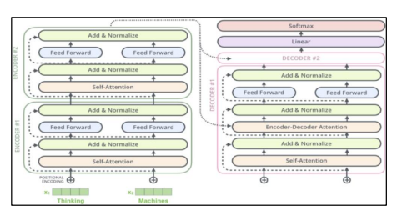
Architecture

Slide 64
Architecture
The Unsupervised Objective:
With the framework, the model architecture, and the unlabeled dataset, the next step is to look for the unsupervised objective which gives the model some ways of learning from the unlabeled data.
In the original text, some words are dropped out with a unique sentinel token.
Words are dropped out independently and uniformly at random. The model is trained to predict basically sentinel tokens to delineate the dropped-out text.
Workflow:
So the model was pretrained based on Bert-base size encoder-decoder transformer with the denoising objective and C4 dataset, It trained 2¹⁹ steps on 2³⁵ or ~348 tokens with inverse square root learning rate schedule.
Finetuning tasks include GLUE, CNN/DM(CNN / Daily Mail), SQuAD, SuperGLUE, and translation tasks: WMT14 EnDe, WMT14 EnFr, and WMT14 EnRo

Slide 65
Discussions
From the perspective of researchers and students who want to harness the power of this glorious model, itssize is a huge obstacle.
The humongous model is more than 30 times the size of established general-purpose NLP models like BERT, and these earlier models are already expensive enough to use on commodity GPU hardware!
This is where Spark NLP jumps in and offers extensive functionality for Text-to-Text Transfer Transformer (T5) and the ability to process it fast and efficiently as it borrows parallelism, concurrency, and distributed computing from its bedrock of Apache Spark.
Since Spark NLP uses Tensorflow under the hood for various operations, it also leverages the performance benefits that the more powerful hardware provides.

Slide 66
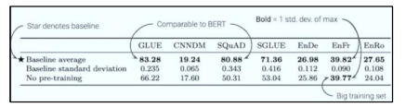
Performance

Slide 67
Applications
The T5 model is trained on several datasets for 18 different tasks which majorly fall into 8 categories:
Text Summarization
Question Answering
Translation
Sentiment analysis
Natural Language Inference,
Coreference Resolution
Sentence Completion
Word Sense Disambiguation

